Slide 1
Cardiovascular Risk Prediction Capstone Project- Classification
By- Anushree Vijay Kajavadekar

Slide 2
Clustering in Machine Learning
Clustering or cluster analysis is a machine learning technique, which groups the unlabelled dataset. It can be defined as "A way of grouping the data points into different clusters, consisting of similar data points. The objects with the possible similarities remain in a group that has less or no similarities with another group."
It does it by finding some similar patterns in the unlabelled dataset such as shape, size, color, behavior, etc., and divides them as per the presence and absence of those similar patterns.

Slide 3

Outline:
1.Problem Statement
2.Data Summary
3.Data Preparation
4. EDA
5. Data Modelling
6.Challenges
7.Conclusion

Slide 4
Problem Statement
The dataset is from an ongoing cardiovascular study on residents of the town of Framingham, Massachusetts.
The classification goal is to predict whether the patient has a 10-year risk of future coronary heart disease (CHD).
The dataset provides the patients’ information. It includes over 4,000 records and 15 attributes. Variables Each attribute is a potential risk factor. There are both demographic, behavioral, and medical risk factors.

Slide 5
Data Summary
The dataset is from an ongoing cardiovascular study on residents of the town of Framingham, Massachusetts. The dataset provides the patient's information and health stats. It includes over 4,000 records and 15 attributes.
Data Description and Attributes:-
id: Patient identification number.
Demographic:
Sex: male or female("M" or "F")
Age: Age of the patient;(Continuous - Although the recorded ages have been truncated to
whole numbers, the concept of age is continuous)
Behavioral
is_smoking: whether or not the patient is a current smoker ("YES" or "NO")
Cigs Per Day: the number of cigarettes that the person smoked on average in one day.(can be
considered continuous as one can have any number of cigarettes, even half a cigarette.)

Slide 6
Medical( history)
BP Meds: whether or not the patient was on blood pressure medication (Nominal)
Prevalent Stroke: whether or not the patient had previously had a stroke (Nominal)
Prevalent Hyp: whether or not the patient was hypertensive (Nominal)
Diabetes: whether or not the patient had diabetes (Nominal)
Medical(current)
Tot Chol: total cholesterol level (Continuous)
Sys BP: systolic blood pressure (Continuous)
Dia BP: diastolic blood pressure (Continuous)
BMI: Body Mass Index (Continuous)
Heart Rate: heart rate (Continuous - In medical research, variables such as heart rate though in
fact discrete, yet are considered continuous because of large number of possible values.)
Glucose: glucose level (Continuous)
Dependent variable (desired target)
*10-year risk of coronary heart disease CHD(binary: “1”, means “Yes”, “0” means “No”)

Slide 7
Data Cleaning
It is the process of finding the inaccurate, incorrect and irrelevant or missing part of a data and then, modifying the data according to our necessity.
In the given data set, I found that there are lot of missing values present.
I removed the null values but it cost us some valuable data loss but given the options, there was no better choice but to remove those rows having nulls as it’s a data from medical domain.
Also the patient ID doesn't contribute their health stats, and it wouldn't be of much help to the model either. Hence, I can drop the "ID" column too.

Slide 8
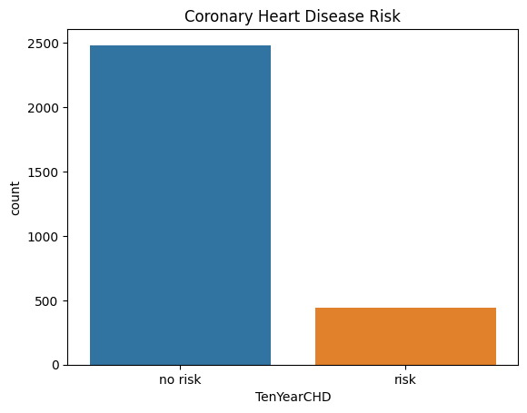
Exploratory Data Analysis
1. TenYearCHD
Here, TenYearCHD signifies if the person has a risk of heart disease or not. Its a binary attribute(binary: “1”, means “Yes”, “0” means “No”) resembling the diagnosis results for patients. We can use this attribute to see how many patients have a risk of CHD.
From the above plot, We can see number of patients with heart disease are significantly low compared to those whose tests came out normal.

Slide 9
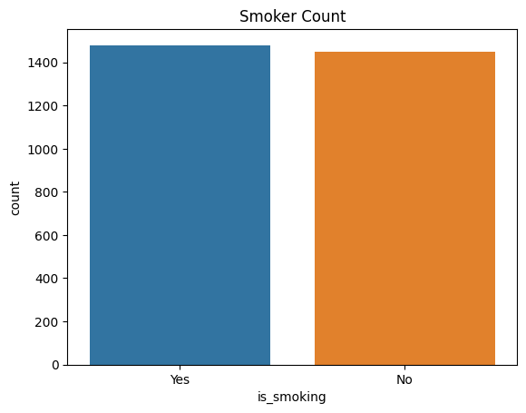
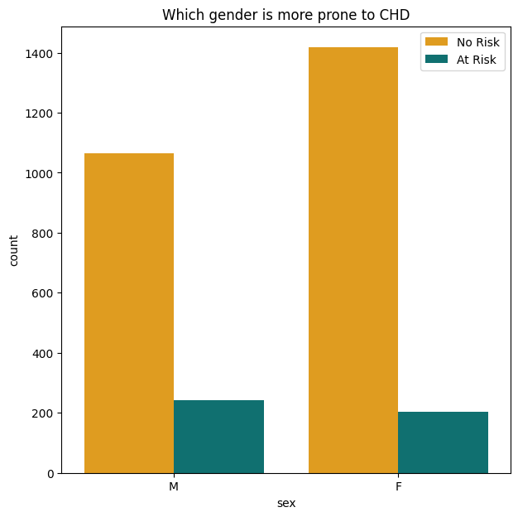
2. Gender
3.Is_Smoking
This Plot shows the number of people who smokes or not.
After finding out the gender wise count for males and females, I found that There's a total of 638 females and 809 males who smokes at least one cigarette a day.
Its clear that number of males who smokes are significantly higher than the female smokers.
We can see that number of female entries are more than males.
Since the data is a bit biased towards females, the model would be much more optimal to predict for a female patient.

Slide 10
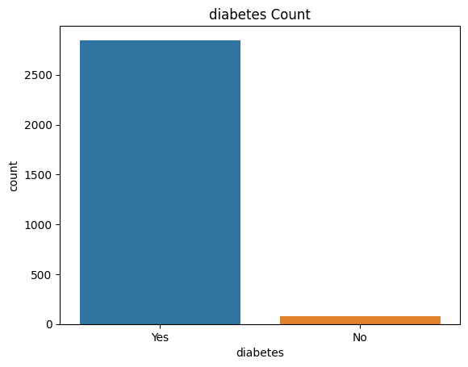
4.Diabetes
We can see that there's a huge gap between the people who have diabetes and to those who doesn't, in fact there are only 79 people who does not have diabetes. This again depicts people who have diabetes are more at risk of CHD.

Slide 11
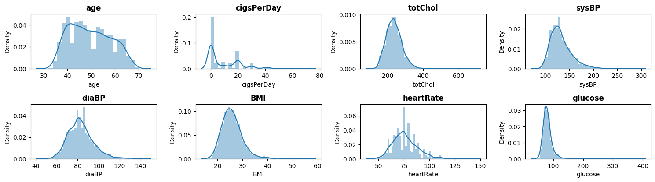
Data Distribution
We can observe that most of the distributions are right skewed for numeric features. totChol (total cholesterol) and BMI have roughly similar distributions, which depicts a linear dependency. Glucose have a highly right skewed distribution, this might lead to some biases. It shows Glucose has a lot of outliers.
Though it is usually a good practice to deal with such outliers, however in this case we can't do much about it. The data is taken through medical survey and the values are patient's health stats, hence those values are absolute and we can't manipulate them by any means.

Slide 12
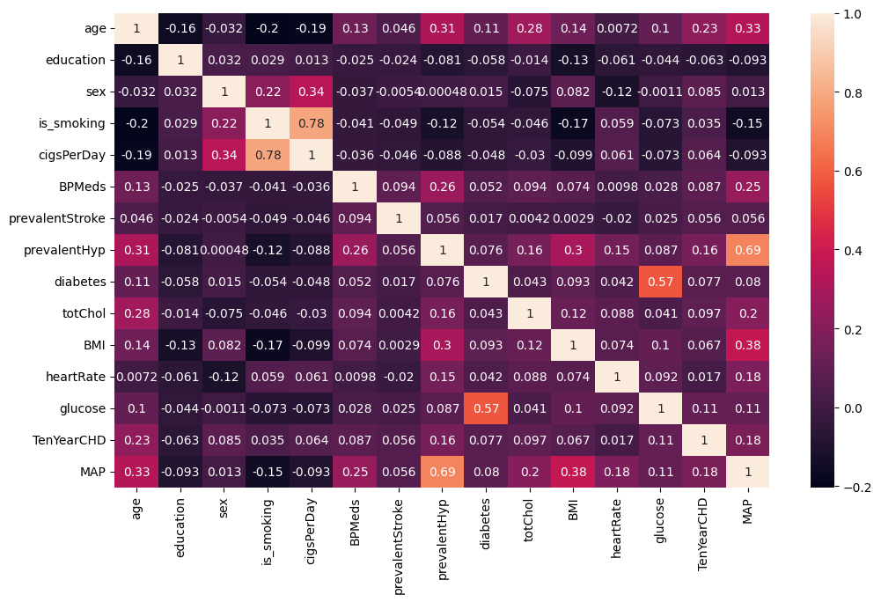
Correlation
DiaBP, SysBP are heavily correlated, there's some relationship we can establish with these two features further.
Mean Artificial Pressure(MAP) = (Systolic Blood Pressure + 2 x Diastolic Blood Pressure) / 3
So I have dropped these columns and add MAP and check for correlation.

Slide 13
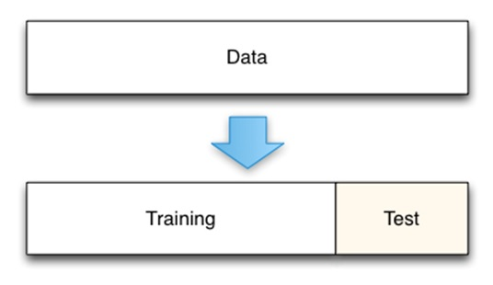
Model Development
1. Training and Testing Data

Slide 14
Linear Regression
Logistic regression is a statistical model that in its basic form uses a logistic function to model a binary dependent variable, although many more complex extensions exist. In regression analysis, logistic regression (or logit regression) is estimating the parameters of a logistic model (a form of binary regression).
Logistic Regression is used when the dependent variable(target) is categorical. The model delivers a binary or dichotomous outcome limited to two possible outcomes: yes/no, 0/1, or true/false.
 |  | Precision | Recall | f1 Score | Support | Model
 | accuracy | 0.654639 | .654639 | 0.654639 | 0.654639 | Logistic Regression Classifier

Slide 15
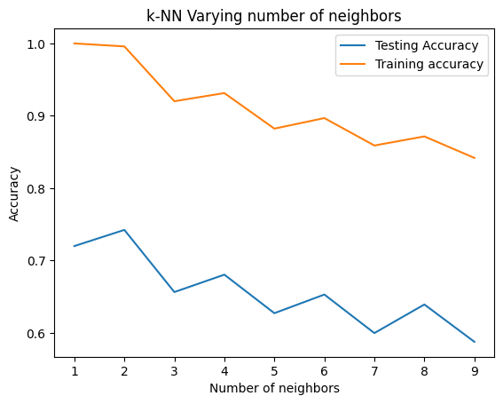
K-Nearest Neighbour(KNN)
KNN which stands for K-Nearest Neighbors is a simple algorithm that is used for classification and regression problems in Machine Learning. KNN is also non-parametric which means the algorithm does not rely on strong assumptions instead tries to learn any functional form from the training data. The K Nearest Neighbor Algorithm can be performed in 4 simple steps.
Step 1: Identify the problem as either falling to classification or regression.
Step 2: Fix a value for k which can be any number greater than zero.
Step 3: Now find k data points that are closest to the unknown/uncategorized datapoint based on distance(Euclidean Distance, Manhattan Distance etc.)
Step 4: Find the solution in either of the following steps:
In case of classification, we assign the uncategorized datapoint to the class where the maximum number of neighbors belonged to.
We can see that neighbors as 2 gives the best test accuracy and hence we'll use this as the best hyperparameter to fit our model.

Slide 16
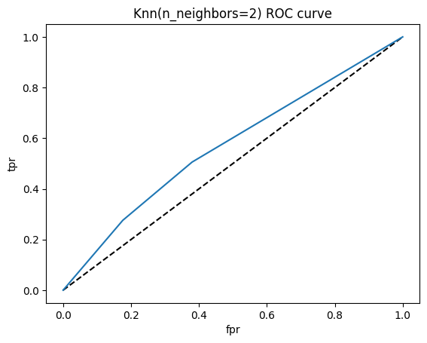
accuracy | 0.742268 | 0.742268 | 0.742268 | 0.742268 | K Nearest Neighbours
precision | recall | f1-score | Support | Model

Slide 17
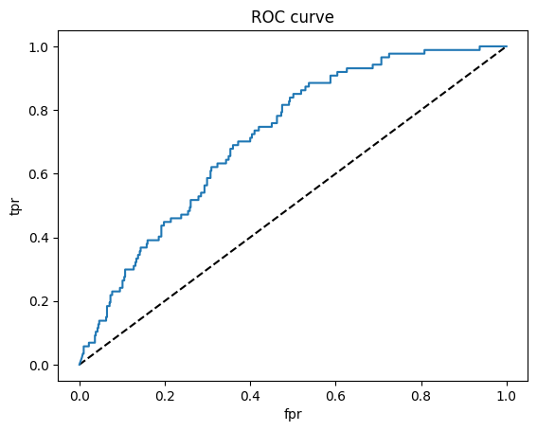
Naive Bayes Classifier
The Naive Bayes algorithm is a classification technique based on the Bayes’ Theorem which assumes there is independence between the features. We interfere with applications utilizing this algorithm on a daily basis, for example it powers recommendation systems for streaming applications or adds on social media as well as many online retail websites.
The simple form of the calculation for Bayes Theorem is as follows:
P(A|B) = P(B|A) * P(A) / P(B)

Slide 18
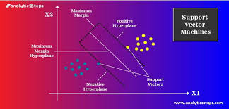
Support Vector Machine
SVM is a powerful supervised algorithm that works best on smaller datasets but on complex ones.
Support Vector Machine, abbreviated as SVM can be used for both regression and classification tasks, but generally, they work best in classification problems.

Slide 19
XGB Classifier
The beauty of this powerful algorithm lies in its scalability, which drives fast learning through parallel and distributed computing and offers efficient memory usage.
XGBoost is an ensemble learning method. Sometimes, it may not be sufficient to rely upon the results of just one machine learning model. Ensemble learning offers a systematic solution to combine the predictive power of multiple learners. The resultant is a single model which gives the aggregated output from several models.
The models that form the ensemble, also known as base learners, could be either from the same learning algorithm or different learning algorithms. Bagging and Boosting are two widely used ensemble learners. Though these two techniques can be used with several statistical models, the most predominant usage has been with decision trees.

Slide 20
Decision Tree
Decision trees can be used for classification as well as regression problems. The name itself suggests that it uses a flowchart like a tree structure to show the predictions that result from a series of feature-based splits. It starts with a root node and ends with a decision made by leaves.
It checks if the condition is true and if it is then it goes to the next node attached to that decision.
In a Decision Tree diagram, we have:
Root Node: The first split which decides the entire population or sample data should further get divided into two or more homogeneous sets. In our case, the Outlook node.
Splitting: It is a process of dividing a node into two or more sub-nodes.
Decision Node: This node decides whether/when a sub-node splits into further sub-nodes or not. Here we have, Outlook node, Humidity node, and Windy node.
Leaf: Terminal Node that predicts the outcome (categorical or continuous value). The coloured nodes, i.e., Yes and No nodes, are the leaves

Slide 21
Random Forest
Random Forest is a technique that uses ensemble learning, that combines many weak classifiers to provide solutions to complex problems.
As the name suggests random forest consists of many decision trees. Rather than depending on one tree it takes the prediction from each tree and based on the majority votes of predictions, predicts the final output.
Random forests use the bagging method. It creates a subset of the original dataset, and the final output is based on majority ranking and hence the problem of overfitting is taken care of.

Slide 22

Results
 | precision |  | f1-score | support | Model
accuracy | 0.654639 | 0.654639 | 0.654639 | 0.654639 | Logistic Regression Classifier
accuracy | 0.742268 | 0.742268 | 0.742268 | 0.742268 | K Nearest Neighbours
accuracy | 0.781787 | 0.781787 | 0.781787 | 0.781787 | Gaussian Naive Bayes Classifier
accuracy | 0.640893 | 0.640893 | 0.640893 | 0.640893 | Support Vector Machine
accuracy | 0.819588 | 0.819588 | 0.819588 | 0.819588 | XGB CLassifier
accuracy | 0.766323 | 0.766323 | 0.766323 | 0.766323 | Decision Tree Classifier
accuracy | 0.838488 | 0.838488 | 0.838488 | 0.838488 | Random Forest Classifier

Slide 23
Challenges
The main issue with the null values in the data set is that they can't be estimated from other data entries. The dataset we are working on is from a medical domain, that said, the entries in this data are person specific and the values vary among different individuals. Its a rare chance the two individuals share same health stats, hence the most logical option that we have to deal with such values is removing the rows with any null value.
We could have tried imputing them using some advance techniques like KNN, but they couldn't be that accurate because it'll use other entries to estimate the nulls, hence the values would depend on the values present among other rows, which isn't a ideal approach for such dataset.

Slide 24
Conclusion
We can see that XBG Classifier and Random forest are the stand out performers among all models.
XGB is with an f1-score of 0.819. It is by far the second highest score we have achieved. Hence, it's safe to say that XGB Classifier provides an optimal solution to our problem.
In case of Logistic regression, We were able to see the maximum f1-score of 0.654, also in case of K-Nearest Neighbors, the f1-score extends up to 0.742.
Naive Bayes Classifier showed a balanced result amongst the model we have implemented, it has a f1-score of 0.781, which is neutral with regards to our observations across various models. But in case of SVM(Support Vector Machines) Classifier, the f1-score lies around 0.640, which also happens to be the lowest score among all models we've implemented.
Out of the tree-based algorithms, the Random Forest Classifier was providing an optimal solution towards achieving our Objective. We were able to achieve an f1-score of 0.838 for the test split, which is higher than any other model. We also noticed that in the case of Decision-tree Classifier, we were able to achieve an f1-score of 0.766 for the test split.
Finally, we can conclude that Random forest and XGB classifier might provide the best results for this particular problem, moreover we can optimize these models using Grid Search CV(cross validation) and hyperparameter tuning to get better results.

Slide 25
Thank you !!

